Slide 1
Next-Activity Prediction for Non-stationary Processes with Unseen Data Variability

Slide 2
Data Variability
Meta level changes -
changes to the structure of an event.
removal of existing attributes, inclusion of new attributes, alteration of the reference name of an existing attribute.
Value level -
deviations of attribute values from values observed in the past.
absence or change in the frequencies of known values, and the appearance of previously unseen values

Slide 3
Final Activity
There exists a subset of termination activities that only appears at the end of sequences and is never preceded by any other activity including the termination activities.
There exists a subset of termination activities that can be preceded and superseded by any activity including termination activities. The termination of a sequence however only occurs after a termination candidate. - considered
Every activity can occur at any place in the sequence and can be a candidate for the sequence termination.

Slide 4
Data Encoding
ordinal encoding for categ vars –> length = log₂(num activities)
Unseen data -> void category strategy, mapped to zero vector
Alternative is additional reserve capacity for every attribute. Additional slots are added to the binary vector for future.
first activity’s event will carry the value ’START’ whereas the final activity’s event will hold the value ’END’ for the life cycle attribute.

Slide 5
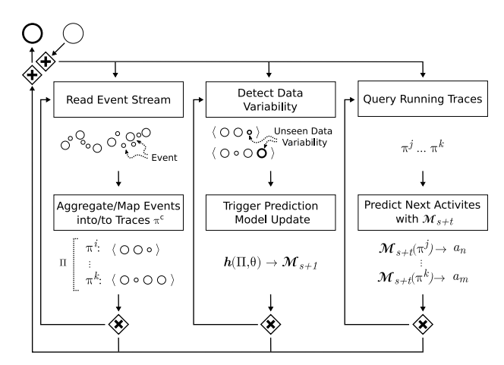
Model
Online prediction
processes incoming events into traces -> adds to database
monitors deviations in database and updates prediction model Ms, based on a model update strategy
predicts a next activity for all incomplete (running) traces
Pred model – modified LSTM 16 hidden cells with a single layer.
4 update strategies (update_versions)
input and output size of the network is dynamically set during the prediction model training and depends on the data observed

Slide 6
Update Strategies
Version 1 – Never update after initial training
Version 2 – Update after every 1 day of data
Version 3 – Update after new activity seen
Version 4 – Update after new sequence seen
Updates can be delayed as well, "when" is under our control
Which traces - >
Sliding window
Expanding window -> considered, once preds made, expand window to include events in prediction window
Batch size 4, epochs 16, early stopping-> take most recent best model

Slide 7
Our Version Extra Details
3 versions of data -
Version1 – application name, activity discovered name, unique id
Version2 – application name, activity discovered name, unique id, title
Version3 – application name, activity discovered name, unique id, title, url
Activity identifier = activity name/ application name
Context length – variable between 3 and 10
Skip – skips in context – variable between 0 and 4

